Slide 1
Day 08
Denavit-Hartenberg

Slide 2
Denavit-Hartenberg Forward Kinematics
RPP cylindrical manipulator
http://strobotics.com/cylindrical-format-robot.htm

Slide 3
Denavit-Hartenberg Forward Kinematics
How do we place the frames?

Slide 4
Step 1: Choose the z-axis for each frame
recall the DH transformation matrix

Slide 5
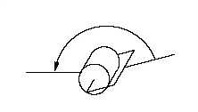
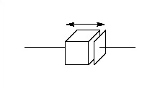
Step 1: Choose the z-axis for each frame
axis of actuation for joint i+1
link i
link i+1
link i
link i+1
joint i+1
joint i+1

Slide 6
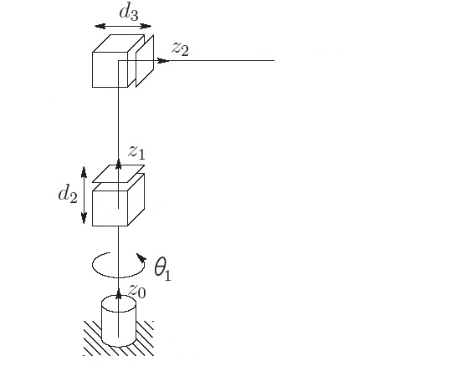
Step 1: Choose the z-axis for each frame
Warning: the picture is deceiving. We do not yet know the origin of the frames; all we know at this point is that each z_{i} points along a joint axis

Slide 7
Step 2: Establish frame {0}
place the origin o₁ anywhere on z₀
often the choice of location is obvious
choose x₀ and y₀ so that {0} is right-handed
often the choice of directions is obvious

Slide 8
Step 2: Establish frame {0}

Slide 9
Step 3: Iteratively construct {1}, {2}, ... {n-1}
using frame {i-1} construct frame {i}
DH1: x_{i} is perpendicular to z_{i-1}
DH2: x_{i} intersects z_{i-1}
3 cases to consider depending on the relationship between z_{i-1} and z_{i}

Slide 10
Step 3: Iteratively construct {1}, {2}, ... {n-1}
Case 1
z_{i-1} and z_{i} are not coplanar (skew)
α_{i} angle from z_{i-1} to z_{i} measured about x_{i}
shortest line between
and
(out of page)
point of intersection

Slide 11
Step 3: Iteratively construct {1}, {2}, ... {n-1}
Case 2
z_{i-1} and z_{i} are parallel ( α_{i} = 0 )
notice that this choice results in d_{i} = 0
point of intersection

Slide 12
Step 3: Iteratively construct {1}, {2}, ... {n-1}
Case 3
z_{i-1} and z_{i} intersect ( a_{i} = 0 )
point of intersection
(out of page)

Slide 13
Step 3: Iteratively construct {1}, {2}, ... {n-1}

Slide 14
Step 3: Iteratively construct {1}, {2}, ... {n-1}

Slide 15
Step 4: Place the end effector frame

Slide 16
Step 4: Place the end effector frame

Slide 17
Step 5: Find the DH parameters
a_{i} : distance between z_{i-1} and z_{i} measured along x_{i}
α_{i} : angle from z_{i-1} and z_{i} measured about x_{i}
d_{i} : distance between o_{i-1} to the intersection of x_{i} and z_{i-1} measured along z_{i-1}
θ_{i} : angle from x_{i-1} and x_{i} measured about z_{i-1}

Slide 18
Step 5: Find the DH parameters
Link | a_{i} | α_{i} | d_{i} | θ_{i}
1 | 0 | 0 | d₁ | θ₁*
2 | 0 | -90 | d₂* | 0
3 | 0 | 0 | d₃* | 0
* joint variable

